Slide 1
Deep Learning for Recommender Systems
Balázs Hidasi
Head of Research @ Gravity R&D
balazs.hidasi@gravityrd.com
RecSys Summer School, 21-25 August, 2017, Bozen-Bolzano

Slide 2
What is Deep Learning?
A class of machine learning algorithms
that use a cascade of multiple non-linear processing layers
and complex model structures
to learn different representations of the data in each layer
where higher level features are derived from lower level features
to form a hierarchical representation

Slide 3
What is Deep Learning?
The second resurgence of neural network research
A useful toolset for
pattern recognition (in various data)
representation learning
A set of techniques that achieve previously unseen results on complex tasks
Computer vision
Natural language processing
Reinforcement learning
Speech recognition
Etc.
A key component of recent intelligent technologies
Personal assistants
Machine translation
Chatbot technology
Self driving cars
Etc.
A new trendy name for neural networks

Slide 4
What is Deep learning NOT?
Deep learning is NOT
AI (especially not general/strong AI)
AI has many to it than just machine learning
It can be part of specialized AIs
Might be part of a future strong AI
the artifical equivalent of the human brain
but techniques in DL are inspired by neuroscience
the best tool for every machine learning task
requires lots of data to work well
computationally expensive
„no guarantees”: theorethical results are few and far between
(mostly) a black box approach
lot of pitfalls

Slide 5

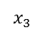
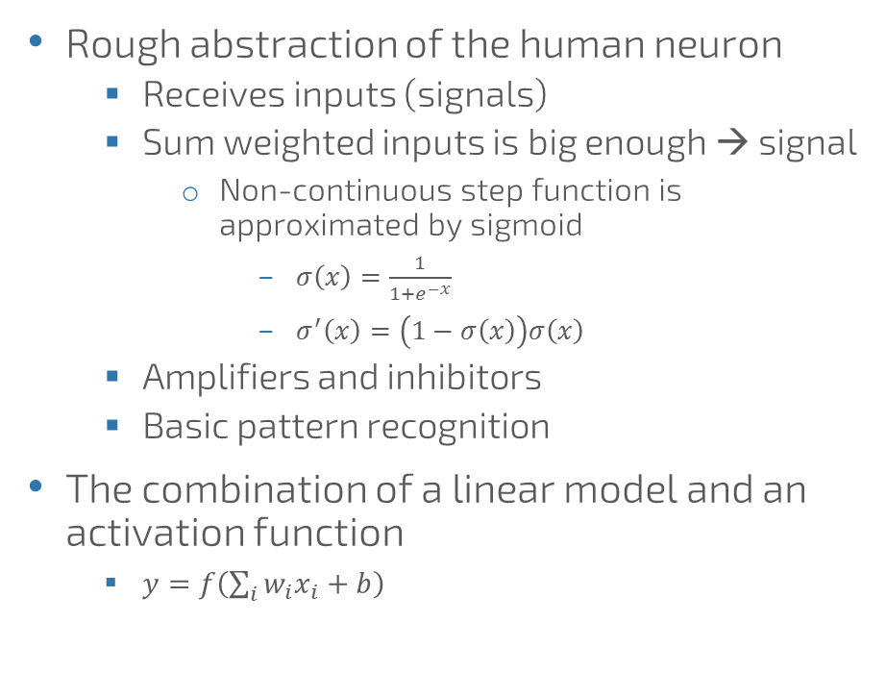
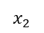
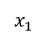

Neural Networks - Neuron
Rough abstraction of the human neuron
Receives inputs (signals)
Sum weighted inputs is big enough → signal
Non-continuous step function is approximated by sigmoid
$σ\left(x\right)=\frac{1}{1+e^{−x}}$
$σ^{′}\left(x\right)=\left(1−σ\left(x\right)\right)σ\left(x\right)$
Amplifiers and inhibitors
Basic pattern recognition
The combination of a linear model and an activation function
$y=f\left(\sum_{i}{w_{i}x_{i}}+b\right)$
$$x_{1}$$
$$x_{2}$$
$$\sum_{i=1}^{N}{w_{i}x_{i}}+b$$
$$f(.)$$
$$x_{3}$$

Slide 6

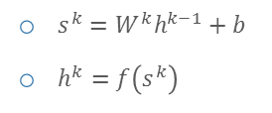


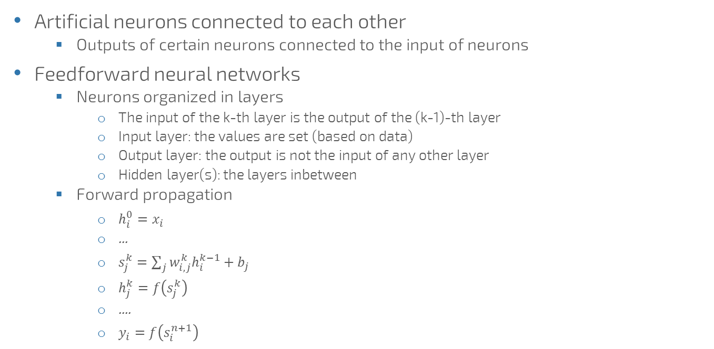



Neural Networks
Artificial neurons connected to each other
Outputs of certain neurons connected to the input of neurons
Feedforward neural networks
Neurons organized in layers
The input of the k-th layer is the output of the (k-1)-th layer
Input layer: the values are set (based on data)
Output layer: the output is not the input of any other layer
Hidden layer(s): the layers inbetween
Forward propagation
$h_{i}^{0}=x_{i}$
...
$s_{j}^{k}=\sum_{j}{w_{i,j}^{k}h_{i}^{k−1}}+b_{j}$
$h_{j}^{k}=f\left(s_{j}^{k}\right)$
....
$y_{i}=f\left(s_{i}^{n+1}\right)$
$$x_{1}$$
$$h_{1}^{\left(1\right)}$$
$s^{k}=W^{k}h^{k−1}+b$
$h^{k}=f\left(s^{k}\right)$
$$h_{1}^{\left(2\right)}$$
$$x_{2}$$
$$h_{2}^{\left(1\right)}$$
$$y$$
$$x_{3}$$
$$h_{2}^{\left(2\right)}$$
$$x_{4}$$
$$h_{3}^{\left(1\right)}$$

Slide 7





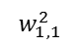
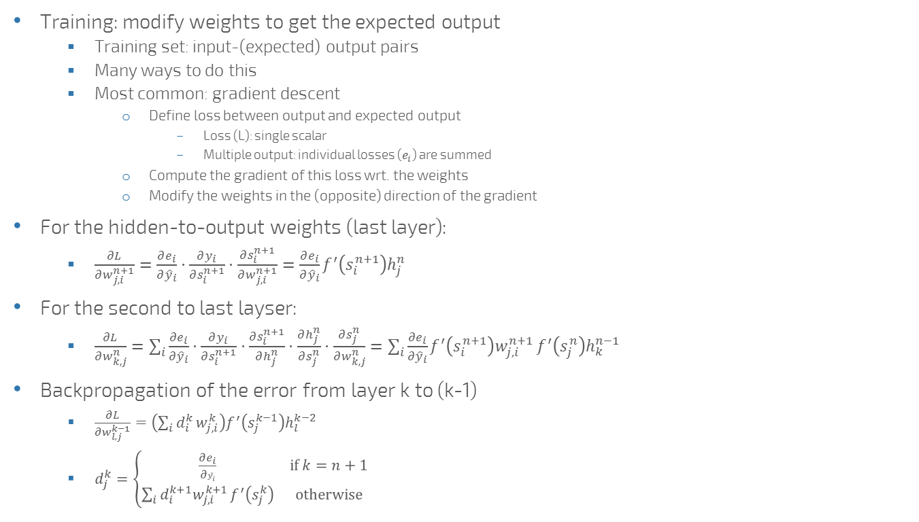

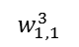



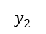
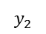

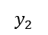


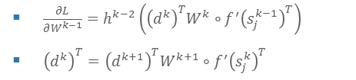

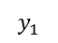

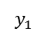

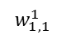





Training Neural Networks - Backpropagation
$$x_{1}$$
$$h_{1}^{\left(1\right)}$$
$$w_{1,1}^{3}$$
Training: modify weights to get the expected output
Training set: input-(expected) output pairs
Many ways to do this
Most common: gradient descent
Define loss between output and expected output
Loss (L): single scalar
Multiple output: individual losses ($e_{i}$) are summed
Compute the gradient of this loss wrt. the weights
Modify the weights in the (opposite) direction of the gradient
For the hidden-to-output weights (last layer):
$\frac{∂L}{∂w_{j,i}^{n+1}}=\frac{∂e_{i}}{∂{\hat{y}}_{i}}⋅\frac{∂y_{i}}{∂s_{i}^{n+1}}⋅\frac{∂s_{i}^{n+1}}{∂w_{j,i}^{n+1}}=\frac{∂e_{i}}{∂{\hat{y}}_{i}}f^{′}\left(s_{i}^{n+1}\right)h_{j}^{n}$
For the second to last layser:
$\frac{∂L}{∂w_{k,j}^{n}}=\sum_{i}{\frac{∂e_{i}}{∂{\hat{y}}_{i}}⋅\frac{∂y_{i}}{∂s_{i}^{n+1}}⋅\frac{∂s_{i}^{n+1}}{∂h_{j}^{n}}}⋅\frac{∂h_{j}^{n}}{∂s_{j}^{n}}⋅\frac{∂s_{j}^{n}}{∂w_{k,j}^{n}}=\sum_{i}{\frac{∂e_{i}}{∂{\hat{y}}_{i}}f^{′}\left(s_{i}^{n+1}\right)w_{j,i}^{n+1}}f^{′}\left(s_{j}^{n}\right)h_{k}^{n−1}$
Backpropagation of the error from layer k to (k-1)
$\frac{∂L}{∂w_{l,j}^{k−1}}=\left(\sum_{i}{d_{i}^{k}}w_{j,i}^{k}\right)f^{′}\left(s_{j}^{k−1}\right)h_{l}^{k−2}$
$d_{j}^{k}=\left\{\begin{matrix}\frac{∂e_{i}}{∂{\hat{y}}_{i}} & if k=n+1 \\ \sum_{i}{d_{i}^{k+1}w_{j,i}^{k+1}}f^{′}\left(s_{j}^{k}\right) & otherwise\end{matrix}\right.$
$$h_{1}^{\left(2\right)}$$
$${\hat{y}}_{1}$$
$$y_{1}$$
$$x_{2}$$
$$h_{2}^{\left(1\right)}$$
$$x_{3}$$
$$h_{2}^{\left(2\right)}$$
$${\hat{y}}_{2}$$
$$y_{2}$$
$$x_{4}$$
$$h_{3}^{\left(1\right)}$$
$$x_{1}$$
$$h_{1}^{\left(1\right)}$$
$$w_{1,1}^{2}$$
$$h_{1}^{\left(2\right)}$$
$${\hat{y}}_{1}$$
$$y_{1}$$
$$x_{2}$$
$$h_{2}^{\left(1\right)}$$
$$x_{3}$$
$$h_{2}^{\left(2\right)}$$
$${\hat{y}}_{2}$$
$$y_{2}$$
$$x_{4}$$
$$h_{3}^{\left(1\right)}$$
$$w_{1,1}^{1}$$
$$h_{1}^{\left(1\right)}$$
$$x_{1}$$
$$h_{1}^{\left(2\right)}$$
$${\hat{y}}_{1}$$
$$y_{1}$$
$$x_{2}$$
$$h_{2}^{\left(1\right)}$$
$$x_{3}$$
$$h_{2}^{\left(2\right)}$$
$${\hat{y}}_{2}$$
$$y_{2}$$
$\frac{∂L}{∂W^{k−1}}=h^{k−2}\left({\left(d^{k}\right)}^{T}W^{k}∘f^{′}{\left(s_{j}^{k−1}\right)}^{T}\right)$
${\left(d^{k}\right)}^{T}={\left(d^{k+1}\right)}^{T}W^{k+1}∘f^{′}{\left(s_{j}^{k}\right)}^{T}$
$$x_{4}$$
$$h_{3}^{\left(1\right)}$$

Slide 8
Why go deep?
Feedforward neural networks are universal approximators
Can approximate any function with arbitarily low error if they are big enough
What is big enough?
Number of layers / neurons
Theoretical „big enough” conditions massively overshoot
Go deep, not wide
For certain functions it is shown
Exists a k number
The number of neurons required for approximating the function is polynomial (in the input) if the network has at least k hidden layers (i.e. deep enough)
Otherwise the number of required units is exponential in the input

Slide 9
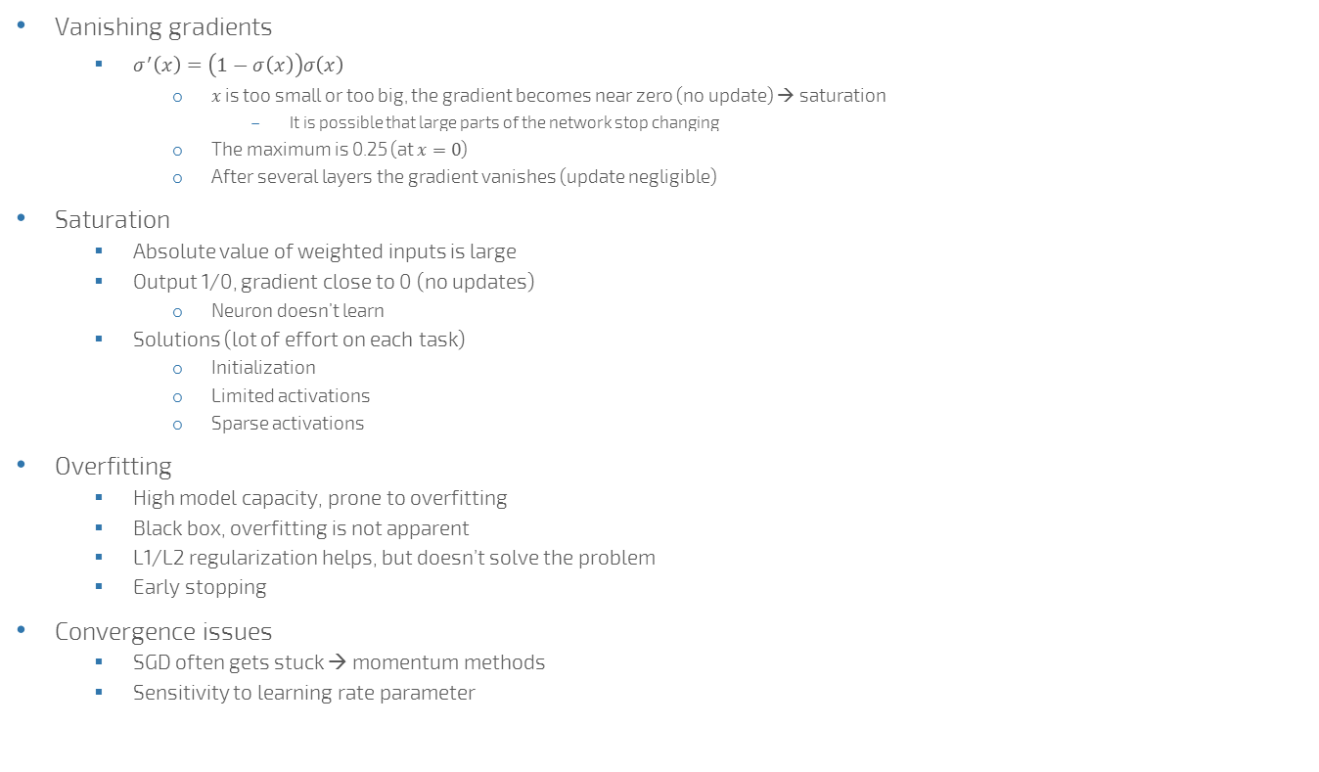
Why was it hard to train neural networks?
Vanishing gradients
$σ^{′}\left(x\right)=\left(1−σ\left(x\right)\right)σ\left(x\right)$
$x$ is too small or too big, the gradient becomes near zero (no update) → saturation
It is possible that large parts of the network stop changing
The maximum is 0.25 (at $x=0$)
After several layers the gradient vanishes (update negligible)
Saturation
Absolute value of weighted inputs is large
Output 1/0, gradient close to 0 (no updates)
Neuron doesn’t learn
Solutions (lot of effort on each task)
Initialization
Limited activations
Sparse activations
Overfitting
High model capacity, prone to overfitting
Black box, overfitting is not apparent
L1/L2 regularization helps, but doesn’t solve the problem
Early stopping
Convergence issues
SGD often gets stuck → momentum methods
Sensitivity to learning rate parameter

Slide 10
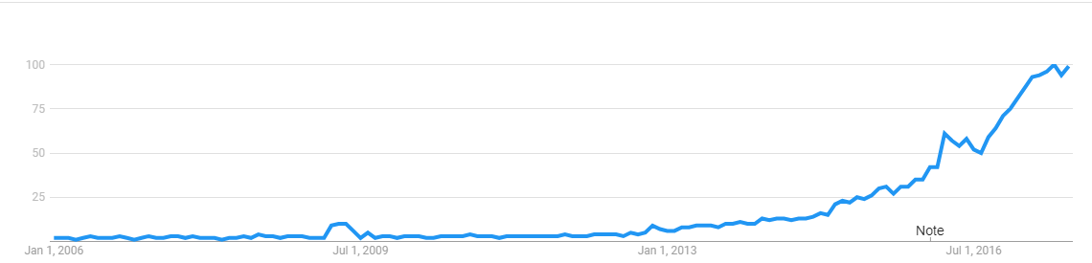
Neural Winters
Reasons:
Inflated expectations
Underdelivering
Hard to train the networks
Results in disappointment
People abandoning the field
Lower funding
First neural winter in the 1970s, second in the 1990s
Gives way to other methods
Deep learning is not new
First deep models were proposed in the late 1960s
The area was revived in the mid-2000s by layerwise training
Deep learning boom has started around 2012-2013

Slide 11






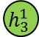
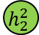

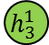

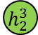


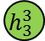
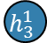










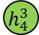






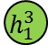

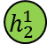
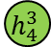

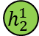

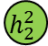



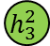



Intermission – Layerwise training
$$x_{1}$$
$$x_{2}$$
$$x_{3}$$
$$x_{4}$$
$$x_{5}$$
$$h_{1}^{1}$$
$$h_{2}^{1}$$
$$h_{3}^{1}$$
Train
$$x_{1}$$
$$x_{2}$$
$$x_{3}$$
$$x_{4}$$
$$x_{5}$$
[Hinton et. al, 2006]
To avoid saturation of the activation functions
Layerwise training:
1. Train a network with a single hidden layer, where the desired output is the same as the input
Unsupervised learning (autoassociative neural network)
The hidden layer learns a latent representation of the input
2. Cut the output layer
3. Train a new network with a single layer, using the hidden layer of the previous network as the input
Repeat from 2 fro some more layers
4. For supervised learning, put a final layer on the top of this structure and optionally fine tune the weights
What happens?
The weights are not initialized randomly
Rather they are set to produce latent representations in the hidden layer
Vanishing gradient is still in the lower layers
No problem, the weights are set to sensible values
Deep Belief Networks (DBN), Deep Boltzmann Machines (DBM)
Was replaced by end-to-end training & non-saturating activations
$$h_{1}^{1}$$
$$h_{2}^{1}$$
$$h_{3}^{1}$$
$$h_{1}^{2}$$
$$h_{2}^{2}$$
Train
$$h_{1}^{1}$$
$$h_{2}^{1}$$
$$h_{3}^{1}$$
Fixed
$$x_{1}$$
$$x_{2}$$
$$x_{3}$$
$$x_{4}$$
$$x_{5}$$
$$y$$
$$h_{2}^{2}$$
$$h_{3}^{2}$$
$$h_{1}^{3}$$
$$h_{2}^{3}$$
$$h_{3}^{3}$$
$$h_{4}^{3}$$
$$h_{1}^{3}$$
$$h_{2}^{3}$$
$$h_{3}^{3}$$
$$h_{4}^{3}$$
Train
$$h_{2}^{2}$$
$$h_{3}^{2}$$
$$h_{2}^{2}$$
$$h_{3}^{2}$$
Fixed
$$h_{1}^{1}$$
$$h_{2}^{1}$$
$$h_{3}^{1}$$
$$h_{1}^{1}$$
$$h_{2}^{1}$$
$$h_{3}^{1}$$
Fixed
$$x_{1}$$
$$x_{2}$$
$$x_{3}$$
$$x_{4}$$
$$x_{5}$$
$$x_{1}$$
$$x_{2}$$
$$x_{3}$$
$$x_{4}$$
$$x_{5}$$

Slide 12
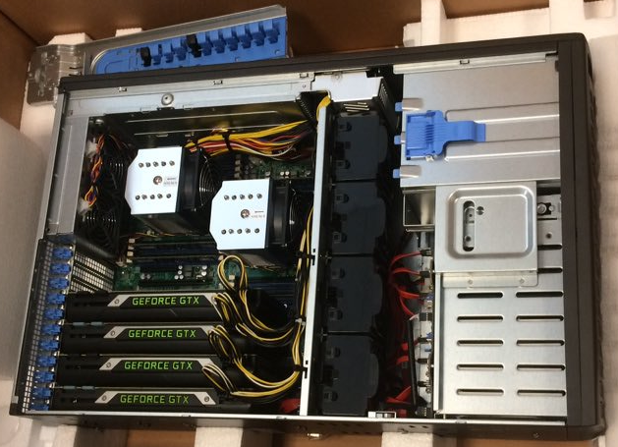
Why now? - Compute
Natural increase in computational power
GP GPU technology
NN rely on matrix and vector operations
Parallelization brings great speed-up
GPU architecture is a good fit

Slide 13
Why now? - Data
Complex models are more efficient when trained on lots of data
The amount of data increased quickly
This includes labelled data as well

Slide 14
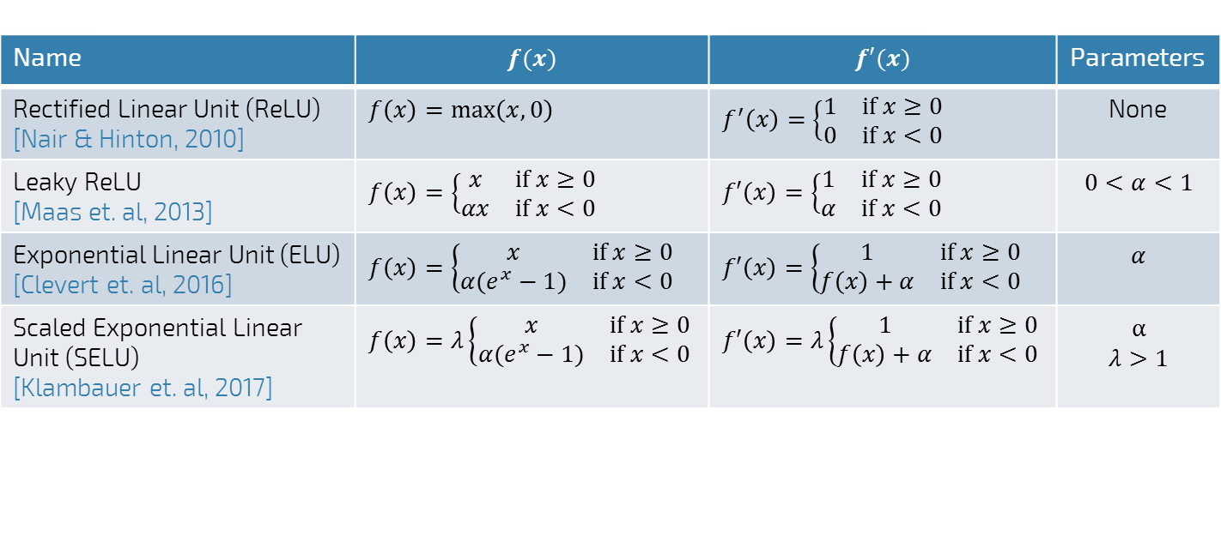
Why now? – Research breakthroughs – Non-saturating activations
Name | $$f(x)$$ | $$f′(x)$$ | Parameters
Rectified Linear Unit (ReLU) [Nair & Hinton, 2010] | $$f\left(x\right)=\max\left(x,0\right)$$ | $$f^{′}\left(x\right)=\left\{\begin{matrix}1 & if x≥0 \\ 0 & if x<0\end{matrix}\right.$$ | None
Leaky ReLU [Maas et. al, 2013] | $$f\left(x\right)=\left\{\begin{matrix}x & if x≥0 \\ αx & if x<0\end{matrix}\right.$$ | $$f′\left(x\right)=\left\{\begin{matrix}1 & if x≥0 \\ α & if x<0\end{matrix}\right.$$ | $$0<α<1$$
Exponential Linear Unit (ELU) [Clevert et. al, 2016] | $$f\left(x\right)=\left\{\begin{matrix}x & if x≥0 \\ α(e^{x}−1) & if x<0\end{matrix}\right.$$ | $$f′\left(x\right)=\left\{\begin{matrix}1 & if x≥0 \\ f\left(x\right)+α & if x<0\end{matrix}\right.$$ | $$α$$
Scaled Exponential Linear Unit (SELU) [Klambauer et. al, 2017] | $$f\left(x\right)=λ\left\{\begin{matrix}x & if x≥0 \\ α(e^{x}−1) & if x<0\end{matrix}\right.$$ | $$f′\left(x\right)=λ\left\{\begin{matrix}1 & if x≥0 \\ f\left(x\right)+α & if x<0\end{matrix}\right.$$ | $$α$$ $$λ>1$$

Slide 15
Why now? – Research breakthroughs – Dropout: easy but efficient regularization
Dropout [Srivastava et. al, 2014]:
During training randomly disable units
Scale the activation of remaining units
So that the average expected activation remains the same
E.g.: dropout=0.5
Disable each unit in the layer with 0.5 probability
Multiply the activation of non-disabled units by 2
No dropout during inference time
Why dropout works?
A form of ensemble training
Multiple configurations are trained with shared weights and averaged in the end
Reduces the reliance of neurons on each other
Each neuron learns something useful
Redundance in pattern recognition
Form of regularization

Slide 16
Why now? – Research breakthroughs – Mini-batch training
Full-batch gradient descent
Compute the average gradient over the full training data
Pass all data points forward & backward
Without changing the weights
Save the updates
Compute the average update and modify the weights
Accurate gradients
Costly updates, but can be parallelized
Stochastic gradient descent
Select a random data point
Do a forward & backwards pass
Update the weights
Repeat
Noisy gradient
Acts as regularization
Cheap updates, but requires more update steps
Overall faster conversion
Mini-batch training
Select N random data points
Do batch training with these N data points
The best of both worlds

Slide 17


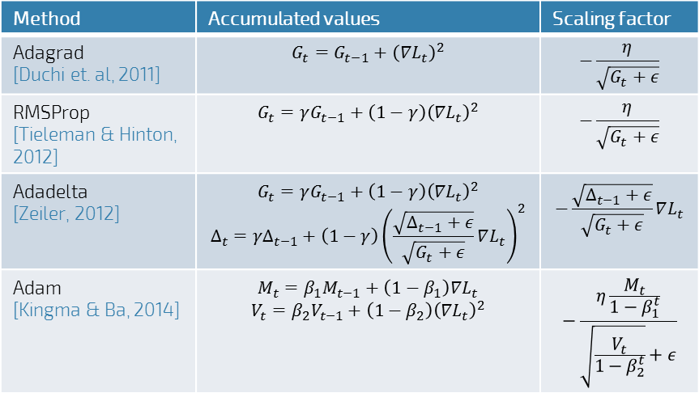
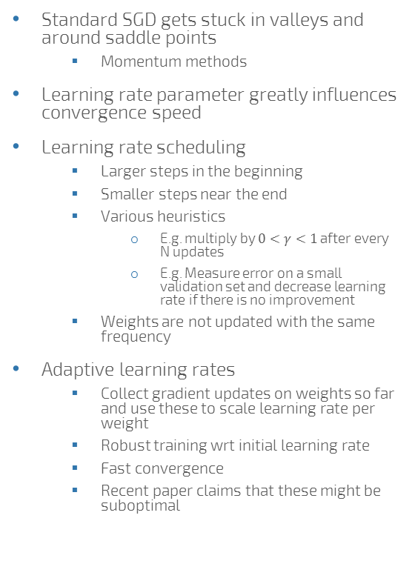
Why now? – Research breakthroughs – Adaptive learning rates
Method | Accumulated values | Scaling factor
Adagrad [Duchi et. al, 2011] | $$G_{t}=G_{t−1}+{\left(∇L_{t}\right)}^{2}$$ | $$−\frac{η}{\sqrt{G_{t}+ε}}$$
RMSProp [Tieleman & Hinton, 2012] | $$G_{t}=γG_{t−1}+\left(1−γ\right){\left(∇L_{t}\right)}^{2}$$ | $$−\frac{η}{\sqrt{G_{t}+ε}}$$
Adadelta [Zeiler, 2012] | $$G_{t}=γG_{t−1}+\left(1−γ\right){\left(∇L_{t}\right)}^{2}$$ $$Δ_{t}=γΔ_{t−1}+\left(1−γ\right){\left(\frac{\sqrt{Δ_{t−1}+ε}}{\sqrt{G_{t}+ε}}∇L_{t}\right)}^{2}$$ | $$−\frac{\sqrt{Δ_{t−1}+ε}}{\sqrt{G_{t}+ε}}∇L_{t}$$
Adam [Kingma & Ba, 2014] | $$M_{t}=β_{1}M_{t−1}+\left(1−β_{1}\right)∇L_{t}$$ $$V_{t}=β_{2}V_{t−1}+\left(1−β_{2}\right){\left(∇L_{t}\right)}^{2}$$ | $$−\frac{η\frac{M_{t}}{1−β_{1}^{t}}}{\sqrt{\frac{V_{t}}{1−β_{2}^{t}}}+ε}$$
Standard SGD gets stuck in valleys and around saddle points
Momentum methods
Learning rate parameter greatly influences convergence speed
Learning rate scheduling
Larger steps in the beginning
Smaller steps near the end
Various heuristics
E.g. multiply by $0<γ<1$ after every N updates
E.g. Measure error on a small validation set and decrease learning rate if there is no improvement
Weights are not updated with the same frequency
Adaptive learning rates
Collect gradient updates on weights so far and use these to scale learning rate per weight
Robust training wrt initial learning rate
Fast convergence
Recent paper claims that these might be suboptimal

Slide 18
Complex deep networks
Modular view
Complex networks are composed from modules appropriate for certain tasks
E.g. Feature extraction with CNN, combined with an RNN for text representation fed to feedforward module
Function approximation
The network is a trainable function in a complex system
E.g. DQN: the Q function is replaced with a trainable neural network
Representation learning
The network learns representations of the entities
These representations are then used as latent features
E.g. Image classification with CNN + a classifier on top

Slide 19
Common building blocks
Network types
Feedforward network (FFN, FNN)
Recurrent network (RNN)
For sequences
Convolutional network (CNN)
Exploiting locality
Supplementary layers
Embedding layer (input)
Output layer
Classifier
Binary
Multiclass
Regressor
Losses (common examples)
Binary classification: logistic loss
Multiclass classification: cross entropy (preceeded by a softmax layer)
Distribution matching: KL divergence
Regression: mean squared error

Slide 20
Common architectures
Single network
Multiple networks merged
Multitask learning architectures
Encoder-decoder
Generative Adversarial Networks (GANs)
And many more...

Slide 21
Impressive results
Few of the many impressive results by DL fom the last year
Image classification accuracy exceeds human baseline
Superhuman performance in certain Atari games
Agent receives only the raw pixel input and the score
AlphaGo beat go world champions
Generative models generate realistic images
Large improvements in machine translation
Improvements in speech recognition
Many production services using deep learning

Slide 22
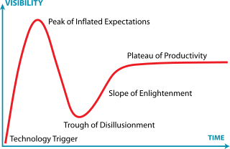
Don’t give in to the hype
Deep learning is impressive but
deep learning is not AI
strong/general AI is very far away
instead of worrying about „sentient” AI, we should focus on the more apparent problems this technological change brings
deep learning is not how the human brain works
not all machine learning tasks require deep learning
deep learning requires a lot of computational power
the theory of deep learning is far behind of its empirical success
this technological change is not without potentially serious issues inflicted on society if we are not careful enough
Deep learning is a tool
which is successful in certain, previously very challenging domains (speech recognition, computer vision, NLP, etc.)
that excels in pattern recognition
You are here

Slide 23
Why deep learning has potential for RecSys?
Feature extraction directly from the content
Image, text, audio, etc.
Instead of metadata
For hybrid algorithms
Heterogenous data handled easily
Dynamic behaviour modeling with RNNs
More accurate representation learning of users and items
Natural extension of CF & more
RecSys is a complex domain
Deep learning worked well in other complex domains
Worth a try

Slide 24
The deep learning era of RecSys
Brief history:
2007: Deep Boltzmann Machines for rating prediction
Also: Asymmetric MF formulated as a neural network (NSVD1)
2007-2014: calm before the storm
Very few, but important papers in this topic
2015: first signs of a deep learning boom
Few seminal papers laying the groundwork for current research directions
2016: steep increase
DLRS workshop series
Deep learning papers at RecSys, KDD, SIGIR, etc.
Distinct research directions are formed by the end of the year
2017: continuation of the increase of DL in recommenders
Current status & way forward
Current research directions to be continued
More advanced ideas from DL are yet to be tried
Scalability is to be kept in mind

Slide 25
Research directions in DL-RecSys
As of 2017 summer, main topics:
Learning item embeddings
Deep collaborative filtering
Feature extraction directly from the content
Session-based recommendations with RNN
And their combinations

Slide 26
Best practices
Start simple
Add improvements later
Optimize code
GPU/CPU optimizations may differ
Scalability is key
Opensource code
Experiment (also) on public datasets
The data should be compatible with the task you want to solve
Don’t use very small datasets
Don’t work on irrelevant tasks, e.g. rating prediction

Slide 27
Frameworks
Low level
Torch, pyTorch - Facebook
Theano – University of Montreal
Tensorflow - Google
MXNet
High level
Keras
Lasagne

Slide 28
References
[Clevert et. al, 2016] DA. Clevert, T. Unterthiner, S. Hochreiter: Fast and accurate deep network learning by exponential linear units (elus). International Conference on Learning Representations (ICLR 2016).
[Duchi et. al, 2011] J. Duchi, E. Hazan, Y. Singer: Adaptive subgradient methods for online learning and stochastic optimization. JMLR 12, 2121–2159 (2011).
[Hinton et. al, 2006] G. Hinton, S. Osindero, YW Teh: A fast learning algorithm for deep belief nets. Neural computation 18.7 (2006): 1527-1554.
[Kingma & Ba, 2014] D. P. Kingma, J. L. Ba: Adam: A method for stochastic optimization. ArXiv preprint (2014) https://arxiv.org/abs/1412.6980.
[Klambauer et. al, 2017] G. Klambauer, T. Unterthiner, A. Mayr, S. Hochreiter, : Self-Normalizing Neural Networks. ArXiv preprint (2017) https://arxiv.org/abs/1706.02515.
[Maas et. al, 2013] A. L. Maas, A. Y. Hannun, A. Y. Ng: Rectifier nonlinearities improve neural network acoustic models. 30th International Conference on Machine Learning (ICML 2013).
[Nair & Hinton, 2010] V. Nair, G. Hinton: Rectiﬁed linear units improve restricted boltzmann machines. 27th International Conference on Machine Learning (ICML 2010).
[Srivastava et. al, 2014] N. Srivastava, G. Hinton, A. Krizhevsky, I. Sutskever, R. Salakhutdinov: Dropout: a simple way to prevent neural networks from overfitting. Journal of machine learning research, 15(1), 1929-1958. 2014.
[Tieleman & Hinton, 2012] T. Tieleman, G. Hinton: Lecture 6.5 - RMSProp, COURSERA: Neural Networks for Machine Learning. Technical report, 2012.
[Zeiler, 2012] M. D. Zeiler: ADADELTA: an adaptive learning rate method. ArXiv preprint (2012) https://arxiv.org/abs/1212.5701.

Slide 29
Learning item embeddings & 2vec models

Slide 30
Item embeddings
Embedding: a (learned) real value vector representing an entity
Also known as:
Latent feature vector
(Latent) representation
Similar entities’ embeddings are similar
Use in recommenders:
Initialization of item representation in more advanced algorithms
Item-to-item recommendations

Slide 31

Matrix factorization as embedding learning
R
U
I
MF: user & item embedding learning
Similar feature vectors
Two items are similar
Two users are similar
User prefers item
MF representation as a simplictic neural network
Input: one-hot encoded user ID
Input to hidden weights: user feature matrix
Hidden layer: user feature vector
Hidden to output weights: item feature matrix
Output: preference (of the user) over the items
Asymmetric MF
Instead of user ID, the input is a vector of interactions over the items
$$≈$$
$$r_{u,1},r_{u,2},…,r_{u,S_{I}}$$
$$W_{I}$$
u
$$W_{U}$$
0,0,...,0,1,0,0,...0

Slide 32
Word2Vec
[Mikolov et. al, 2013a]
Representation learning of words
Shallow model
Linear operations in the vector space can be associated with semantics
king – man + woman ~ queen
Paris – France + Italy ~ Rome
Data: (target) word + context pairs
Sliding window on the document
Context = words near the target
In sliding window
1-5 words in both directions
Two models
Continous Bag of Words (CBOW)
Skip-gram

Slide 33
Word2Vec - CBOW
word(t)
Classifier
averaging
Continuous Bag of Words
Maximalizes the probability of the target word given the context
Model
Input: one-hot encoded words
Input to hidden weights
Embedding matrix of words
Hidden layer
Sum of the embeddings of the words in the context
Hidden to output weights
Softmax transformation
Smooth approximation of the max operator
Highlights the highest value
$s_{i}=\frac{e^{r_{i}}}{\sum_{j=1}^{N}{e^{r_{j}}}}$, ($r_{j}$: scores)
Output: likelihood of words of the corpus given the context
Embeddings are taken from the input to hidden matrix
Hidden to output matrix also has item representations (but not used)
$$w_{t−2}$$
$$w_{t−1}$$
$$w_{t+1}$$
$$w_{t+2}$$
E
E
E
E
word(t-2)
word(t-1)
word(t+1)
word(t+2)
$${\left\{p(w_{i}|c)\right\}}_{i=1}^{N}$$
softmax
$${\left\{r_{i}\right\}}_{i=1}^{N}$$
$$W$$
$$E$$
0,1,0,0,1,0,0,1,0,1

Slide 34
Word2Vec – Skip-gram
word(t-2)
word(t-1)
word(t+1)
word(t+2)
Classifier
Maximalizes the probability of the context, given the target word
Model
Input: one-hot encoded word
Input to hidden matrix: embeddings
Hidden state
Item embedding of target
Softmax transformation
Output: likelihood of context words (given the input word)
Reported to be more accurate
$$w_{t}$$
E
word(t)
$${\left\{p(w_{i}|c)\right\}}_{i=1}^{N}$$
softmax
$${\left\{r_{i}\right\}}_{i=1}^{N}$$
$$W$$
$$E$$
0,0,0,0,1,0,0,0,0,0

Slide 35
Speed-up
Hierarchical softmax [Morin & Bengio, et. al, 2005]
Softmax computation requires every score
Reduce computations to $O\left(\log_{2}{N}\right)$ by using a binary tree
Leaves words
Each inner node has a trainable vector (v)
$σ\left(v^{T}v_{c}\right)$ is the probability that the left child of the current node is the next step we have to take in the tree
Probability of a word: $p\left(w | w_{c}\right)=\prod_{j=1}^{L\left(w_{t}\right)−1}{σ\left(I_{n\left(w,j+1\right)=ch\left(n\left(w,j\right)\right)}v_{n\left(w,j\right)}^{T}v_{c}\right)}$
$n(w,j)$: j-th node on the path to w
$ch(n)$: left child of node $n$
During learning the vectors in the nodes are modified so that the target word becomes more likely
Skip-gram with negative sampling (SGNS) [Mikolov, et. al, 2013b]
Input: target word
Desired output: sampled word from context
Score is computed for the desired output and a few negative samples

Slide 36




Paragraph2vec, doc2vec
word(t)
[Le & Mikolov, 2014]
Learns representation of paragraph/document
Based on CBOW model
Paragraph/document embedding added to the model as global context
Classifier
averaging
$$p_{i}$$
$$w_{t−2}$$
$$w_{t−1}$$
$$w_{t+1}$$
$$w_{t+2}$$
P
E
E
E
E
paragraph ID
word(t-2)
word(t-1)
word(t+1)
word(t+2)

Slide 37
Prod2Vec
[Grbovic et. al, 2015]
Skip-gram model on products
Input: i-th product purchased by the user
Context: the other purchases of the user
Bagged prod2vec model
Input: products purchased in one basket by the user
Basket: sum of product embeddings
Context: other baskets of the user
Learning user representation
Follows paragraph2vec
User embedding added as global context
Input: user + products purchased except for the i-th
Target: i-th product purchased by the user
[Barkan & Koenigstein, 2016] proposed the same model later as item2vec
Skip-gram with Negative Sampling (SGNS) is applied to event data

Slide 38

Utilizing more information
meta(t-1)
item(t-1)
item(t)
meta(t+1)
item(t+2)
Meta-Prod2vec [Vasile et. al, 2016]
Based on the prod2vec model
Uses item metadata
Embedded metadata
Added to both the input and the context
Losses between: target/context item/metadata
Final loss is the combination of 5 of these losses
Content2vec [Nedelec et. al, 2017]
Separate moduls for multimodel information
CF: Prod2vec
Image: AlexNet (a type of CNN)
Text: Word2Vec and TextCNN
Learns pairwise similarities
Likelihood of two items being bought together
Classifier
Classifier
Classifier
Classifier
Classifier
$$i_{t}$$
$$m_{t}$$
I
M
item(t)
meta(t)

Slide 39
References
[Barkan & Koenigstein, 2016] O. Barkan, N. Koenigstein: ITEM2VEC: Neural item embedding for collaborative filtering. IEEE 26th International Workshop on Machine Learning for Signal Processing (MLSP 2016).
[Grbovic et. al, 2015] M. Grbovic, V. Radosavljevic, N. Djuric, N. Bhamidipati, J. Savla, V. Bhagwan, D. Sharp: E-commerce in Your Inbox: Product Recommendations at Scale. 21th ACM SIGKDD International Conference on Knowledge Discovery and Data Mining (KDD’15).
[Le & Mikolov, 2014] Q. Le, T. Mikolov: Distributed Representations of Sentences and Documents. 31st International Conference on Machine Learning (ICML 2014).
[Mikolov et. al, 2013a] T. Mikolov, K. Chen, G. Corrado, J. Dean: Efficient Estimation of Word Representations in Vector Space. ICLR 2013 Workshop.
[Mikolov et. al, 2013b] T. Mikolov, I. Sutskever, K. Chen, G. Corrado, J. Dean: Distributed Representations of Words and Phrases and Their Compositionality. 26th Advances in Neural Information Processing Systems (NIPS 2013).
[Morin & Bengio, 2005] F. Morin, Y. Bengio: Hierarchical probabilistic neural network language model. International workshop on artificial intelligence and statistics, 2005.
[Nedelec et. al, 2017] T. Nedelec, E. Smirnova, F. Vasile: Specializing Joint Representations for the task of Product Recommendation. 2nd Workshop on Deep Learning for Recommendations (DLRS 2017).
[Vasile et. al, 2016] F. Vasile, E. Smirnova, A. Conneau: Meta-Prod2Vec – Product Embeddings Using Side-Information for Recommendations. 10th ACM Conference on Recommender Systems (RecSys’16).

Slide 40
Deep collaborative filtering

Slide 41
CF with Neural Networks
Natural application area
Some exploration during the Netflix prize
E.g.: NSVD1 [Paterek, 2007]
Asymmetric MF
The model:
Input: sparse vector of interactions
Item-NSVD1: ratings given for the item by users
Alternatively: metadata of the item
User-NSVD1: ratings given by the user
Input to hidden weights: „secondary” feature vectors
Hidden layer: item/user feature vector
Hidden to output weights: user/item feature vectors
Output:
Item-NSVD1: predicted ratings on the item by all users
User-NSVD1: predicted ratings of the user on all items
Training with SGD
Implicit counterpart by [Pilászy et. al, 2009]
No non-linarities in the model
Predicted ratings
Item feature
vectors
User features
Secondary feature
vectors
Ratings of the user

Slide 42
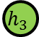
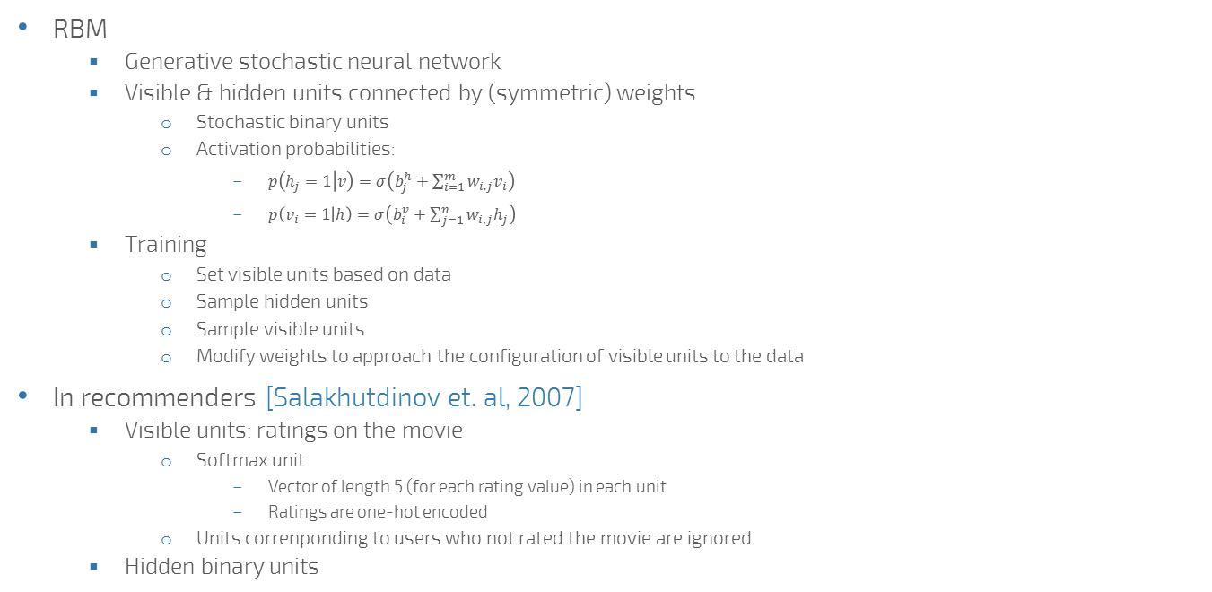


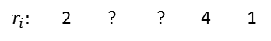

Restricted Boltzmann Machines (RBM) for recommendation
RBM
Generative stochastic neural network
Visible & hidden units connected by (symmetric) weights
Stochastic binary units
Activation probabilities:
$p\left(h_{j}=1 | v\right)=σ\left(b_{j}^{h}+\sum_{i=1}^{m}{w_{i,j}v_{i}}\right)$
$p\left(v_{i}=1 | h\right)=σ\left(b_{i}^{v}+\sum_{j=1}^{n}{w_{i,j}h_{j}}\right)$
Training
Set visible units based on data
Sample hidden units
Sample visible units
Modify weights to approach the configuration of visible units to the data
In recommenders [Salakhutdinov et. al, 2007]
Visible units: ratings on the movie
Softmax unit
Vector of length 5 (for each rating value) in each unit
Ratings are one-hot encoded
Units correnponding to users who not rated the movie are ignored
Hidden binary units
$$h_{1}$$
$$h_{2}$$
$$h_{3}$$
$$v_{1}$$
$$v_{2}$$
$$v_{3}$$
$$v_{4}$$
$$v_{5}$$
$$h_{1}$$
$$h_{2}$$
$$h_{3}$$
$$v_{1}$$
$$v_{2}$$
$$v_{3}$$
$$v_{4}$$
$$v_{5}$$
$r_{i}:$ 2 ? ? 4 1

Slide 43
Deep Boltzmann Machines (DBM)
$$h_{1}^{1}$$
$$h_{2}^{1}$$
$$h_{3}^{1}$$
Train
$$v_{1}$$
$$v_{2}$$
$$v_{3}$$
$$v_{4}$$
$$v_{5}$$
Layer-wise training
Train weights between visible and hidden units in an RBM
Add a new layer of hidden units
Train weights connecting the new layer to the network
All other weights (e.g. visible-hidden weights) are fixed
$$h_{1}^{2}$$
$$h_{2}^{2}$$
Train
$$h_{1}^{1}$$
$$h_{2}^{1}$$
$$h_{3}^{1}$$
Fixed
$$v_{1}$$
$$v_{2}$$
$$v_{3}$$
$$v_{4}$$
$$v_{5}$$
$$h_{1}^{3}$$
$$h_{2}^{3}$$
$$h_{3}^{3}$$
$$h_{4}^{3}$$
Train
$$h_{2}^{2}$$
$$h_{3}^{2}$$
Fixed
$$h_{1}^{1}$$
$$h_{2}^{1}$$
$$h_{3}^{1}$$
Fixed
$$v_{1}$$
$$v_{2}$$
$$v_{3}$$
$$v_{4}$$
$$v_{5}$$

Slide 44
Autoencoders
Data
Autoencoder
One hidden layer
Same number of input and output units
Try to reconstruct the input on the output
Hidden layer: compressed representation of the data
Constraining the model: improve generalization
Sparse autoencoders
Activations of units is limited
Activation penalty
Requires the whole train set to compute
Denoising autoencoders [Vincent et. al, 2008]
Corrupt the input (e.g. set random values to zero)
Restore the original on the output
Deep version
Stacked autoencoders
Layerwise training (historically)
End-to-end training (more recently)
Reconstructed output
Hidden layer
Corrupted input
Data

Slide 45
Autoencoders for recommendation
Reconstruct corrupted user interaction vectors
Variants
CDL [Wang et. al, 2015]
Collaborative Deep Learning
Uses Bayesian stacked denoising autoencoders
Uses tags/metadata instead of the item ID
CDAE [Wu et. al, 2016]
Collaborative Denoising Auto-Encoder
Additional user node on the input and bias node beside the hidden layer

Slide 46
Recurrent autoencoder
CRAE [Wang et. al, 2016]
Collaborative Recurrent Autoencoder
Encodes text (e.g. movie plot, review)
Autoencoding with RNNs
Encoder-decoder architecture
The input is corrupted by replacing words with a deisgnated BLANK token
CDL model + text encoding simultaneously
Joint learning

Slide 47
Other DeepCF methods (1/2)
MV-DNN [Elkahky et. al, 2015]
Multi-domain recommender
Separate feedforward networks for user and items per domain (D+1 networks in total)
Features first are embedded
Then runthrough sevaral layers
Similarity of the final layers (user and item representation) is maximized over items the user visited (against negative examples)
TDSSM [Song et. al, 2016]
Temporal Deep Semantic Structured Model
Similar to MV-DNN
User features are the combination of a static and a time dependent part
The time dependent part is modeled by an RNN
Coevolving features [Dai et. al, 2016]
Users’ taste and items’ audiences change over time (e.g. forum discussions)
User/item features depend on time
User/item features are composed of
Time drift vector
Self evolution
Co-evolution with items/users
Interaction vector
Feature vectors are learned by RNNs

Slide 48
Other DeepCF methods (2/2)
Product Neural Network (PNN) [Qu et. al, 2016]
For CTR estimation
Embedded features
Pairwise layer: all pairwise combination of embedded features
Like Factorization Machines
Outer/inner product of feature vectors or both
Several fully connected layers
CF-NADE [Zheng et. al, 2016]
Neural Autoregressive Collaborative Filtering
User events → preference (0/1) + confidence (based on occurence)
Reconstructs some of the user events based on others (not the full set)
Random ordering of user events
Reconstruct the preference i, based on preferences and confidences up to i-1
Loss is weighted by confidences

Slide 49
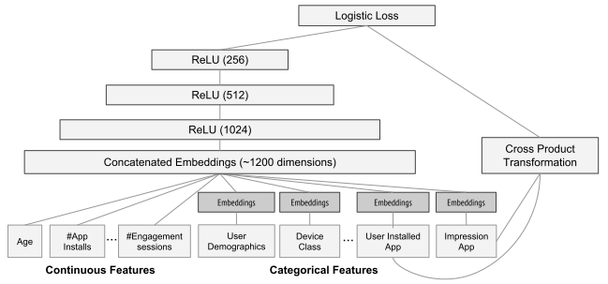
Applications: app recommendations
Wide & Deep Learning [Cheng et. al, 2016]
Ranking of results matching a query
Combination of two models
Deep neural network
On embedded item features
„Generalization”
Linear model
On embedded item features
And cross product of item features
„Memorization”
Joint training
Logistic loss
Improved online performance
+2.9% deep over wide
+3.9% deep+wide over wide

Slide 50
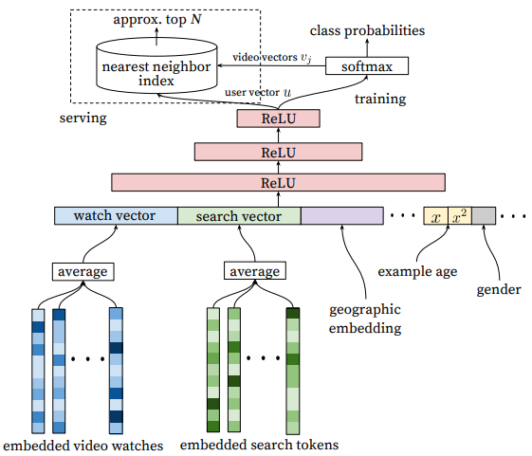
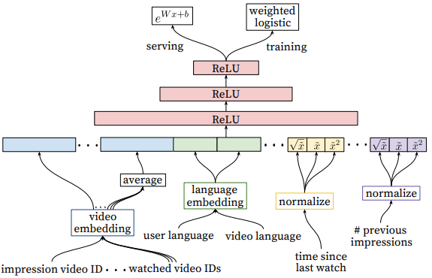
Applications: video recommendations
YouTube Recommender [Covington et. al, 2016]
Two networks
Candidate generation
Recommendations as classification
Items clicked / not clicked when were recommended
Feedforward network on many features
Average watch embedding vector of user (last few items)
Average search embedding vector of user (last few searches)
User attributes
Geographic embedding
Negative item sampling + softmax
Reranking
More features
Actual video embedding
Average video embedding of watched videos
Language information
Time since last watch
Etc.
Weighted logistic regression on the top of the network

Slide 51
References
[Cheng et. al, 2016] HT. Cheng, L. Koc, J. Harmsen, T. Shaked, T. Chandra, H. Aradhye, G. Anderson, G. Corrado, W. Chai, M. Ispir, R. Anil, Z. Haque, L. Hong, V. Jain, X. Liu, H. Shah: Wide & Deep Learning for Recommender Systems. 1st Workshop on Deep Learning for Recommender Systems (DLRS 2016).
[Covington et. al, 2016] P. Covington, J. Adams, E. Sargin: Deep Neural Networks for YouTube Recommendations. 10th ACM Conference on Recommender Systems (RecSys’16).
[Dai et. al, 2016] H. Dai, Y. Wang, R. Trivedi, L. Song: Recurrent Co-Evolutionary Latent Feature Processes for Continuous-time Recommendation. 1st Workshop on Deep Learning for Recommender Systems (DLRS 2016).
[Elkahky et. al, 2015] A. M. Elkahky, Y. Song, X. He: A Multi-View Deep Learning Approach for Cross Domain User Modeling in Recommendation Systems. 24th International Conference on World Wide Web (WWW’15). [Paterek, 2007] A. Paterek: Improving regularized singular value decomposition for collaborative filtering. KDD Cup and Workshop 2007.
[Paterek, 2007] A. Paterek: Improving regularized singular value decomposition for collaborative filtering. KDD Cup 2007 Workshop.
[Pilászy & Tikk, 2009] I. Pilászy, D. Tikk: Recommending new movies: even a few ratings are more valuable than metadata. 3rd ACM Conference on Recommender Systems (RecSys’09).
[Qu et. al, 2016] Y. Qu, H. Cai, K. Ren, W. Zhang, Y. Yu: Product-based Neural Networks for User Response Prediction. 16th International Conference on Data Mining (ICDM 2016).
[Salakhutdinov et. al, 2007] R. Salakhutdinov, A. Mnih, G. Hinton: Restricted Boltzmann Machines for Collaborative Filtering. 24th International Conference on Machine Learning (ICML 2007).
[Song et. al, 2016] Y. Song, A. M. Elkahky, X. He: Multi-Rate Deep Learning for Temporal Recommendation. 39th International ACM SIGIR conference on Research and Development in Information Retrieval (SIGIR’16).
[Vincent et. al, 2008] P. Vincent, H. Larochelle, Y. Bengio, P. A. Manzagol: Extracting and Composing Robust Features with Denoising Autoencoders. 25th international Conference on Machine Learning (ICML 2008).
[Wang et. al, 2015] H. Wang, N. Wang, DY. Yeung: Collaborative Deep Learning for Recommender Systems. 21th ACM SIGKDD International Conference on Knowledge Discovery and Data Mining (KDD’15).
[Wang et. al, 2016] H. Wang, X. Shi, DY. Yeung: Collaborative Recurrent Autoencoder: Recommend while Learning to Fill in the Blanks. Advances in Neural Information Processing Systems (NIPS 2016).
[Wu et. al, 2016] Y. Wu, C. DuBois, A. X. Zheng, M. Ester: Collaborative Denoising Auto-encoders for Top-n Recommender Systems. 9th ACM International Conference on Web Search and Data Mining (WSDM’16)
[Zheng et. al, 2016] Y. Zheng, C. Liu, B. Tang, H. Zhou: Neural Autoregressive Collaborative Filtering for Implicit Feedback. 1st Workshop on Deep Learning for Recommender Systems (DLRS 2016).

Slide 52
Feature extraction from content for hydrid recommenders

Slide 53
Content features in recommenders
Hybrid CF+CBF systems
Interaction data + metadata
Model based hybrid solutions
Initiliazing
Obtain item representation based on metadata
Use this representation as initial item features
Regularizing
Obtain metadata based representations
The interaction based representation should be close to the metadata based
Add regularizing term to loss of this difference
Joining
Obtain metadata based representations
Have the item feature vector be a concatenation
Fixed metadata based part
Learned interaction based part

Slide 54
Feature extraction from content
Deep learning is capable of direct feature extraction
Work with content directly
Instead (or beside) metadata
Images
E.g.: product pictures, video thumbnails/frames
Extraction: convolutional networks
Applications (e.g.):
Fashion
Video
Text
E.g.: product description, content of the product, reviews
Extraction
RNNs
1D convolution networks
Weighted word embeddings
Paragraph vectors
Applications (e.g.):
News
Books
Publications
Music/audio
Extraction: convolutional networks (or RNNs)

Slide 55
Convolutional Neural Networks (CNN)
Speciality of images
Huge amount of information
3 channels (RGB)
Lots of pixels
Number of weights required to fully connect a 320x240 image to 2048 hidden units:
3*320*240*2048 = 471,859,200
Locality
Objects’ presence are independent of their location or orientation
Objects are spatially restricted

Slide 56
Convolutional Neural Networks (CNN)
Image input
3D tensor
Width
Height
Channels (R,G,B)
Text/sequence inputs
Matrix
of one-hot encoded entities
Inputs must be of same size
Padding
(Classic) Convolutional Nets
Convolution layers
Pooling layers
Fully connected layers

Slide 57
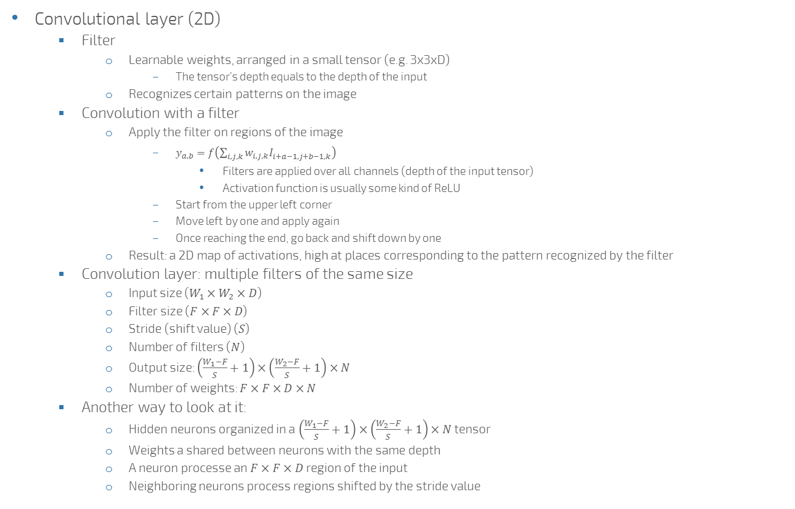
Convolutional Neural Networks (CNN)
Convolutional layer (2D)
Filter
Learnable weights, arranged in a small tensor (e.g. 3x3xD)
The tensor’s depth equals to the depth of the input
Recognizes certain patterns on the image
Convolution with a filter
Apply the filter on regions of the image
$y_{a,b}=f\left(\sum_{i,j,k}{w_{i,j,k}I_{i+a−1,j+b−1,k}^{}}\right)$
Filters are applied over all channels (depth of the input tensor)
Activation function is usually some kind of ReLU
Start from the upper left corner
Move left by one and apply again
Once reaching the end, go back and shift down by one
Result: a 2D map of activations, high at places corresponding to the pattern recognized by the filter
Convolution layer: multiple filters of the same size
Input size ($W_{1}×W_{2}×D$)
Filter size ($F×F×D$)
Stride (shift value) ($S$)
Number of filters ($N$)
Output size: $\left(\frac{W_{1}−F}{S}+1\right)×\left(\frac{W_{2}−F}{S}+1\right)×N$
Number of weights: $F×F×D×N$
Another way to look at it:
Hidden neurons organized in a $\left(\frac{W_{1}−F}{S}+1\right)×\left(\frac{W_{2}−F}{S}+1\right)×N$ tensor
Weights a shared between neurons with the same depth
A neuron processe an $F×F×D$ region of the input
Neighboring neurons process regions shifted by the stride value
1
3
8
0
0
7
2
1
-1
-2
-1
48
-27
2
5
5
1
-2
12
-2
19
28
4
2
3
0
-1
-2
-1

Slide 58
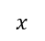
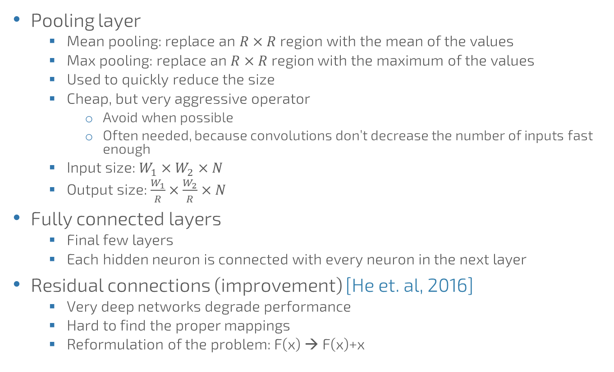
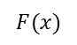
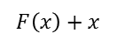
Convolutional Neural Networks (CNN)
Pooling layer
Mean pooling: replace an $R×R$ region with the mean of the values
Max pooling: replace an $R×R$ region with the maximum of the values
Used to quickly reduce the size
Cheap, but very aggressive operator
Avoid when possible
Often needed, because convolutions don’t decrease the number of inputs fast enough
Input size: $W_{1}×W_{2}×N$
Output size: $\frac{W_{1}}{R}×\frac{W_{2}}{R}×N$
Fully connected layers
Final few layers
Each hidden neuron is connected with every neuron in the next layer
Residual connections (improvement) [He et. al, 2016]
Very deep networks degrade performance
Hard to find the proper mappings
Reformulation of the problem: F(x) → F(x)+x
$$x$$
Layer
Layer
$$F(x)$$
+
$$F\left(x\right)+x$$

Slide 59
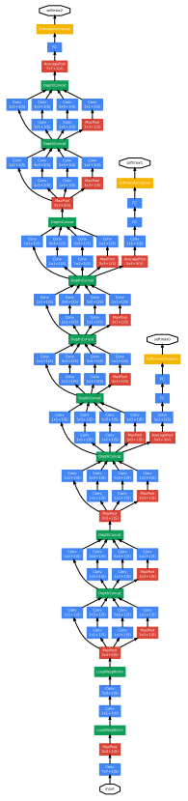
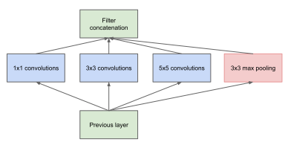
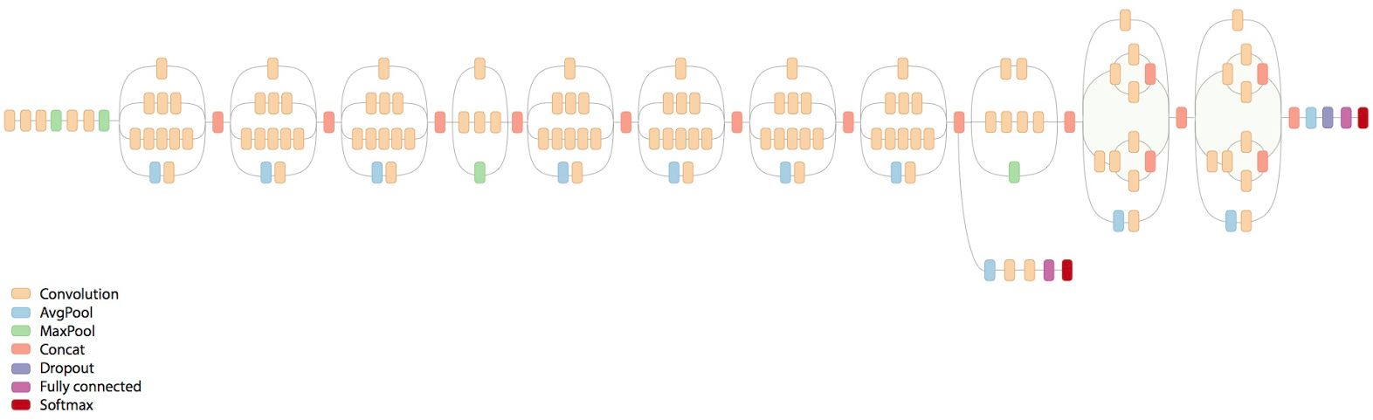
Convolutional Neural Networks (CNN)
Some examples
GoogLeNet [Szegedy et. al, 2015]
Inception-v3 model [Szegedy et. al, 2016]
ResNet (up to 200+ layers) [He et. al, 2016]

Slide 60
Images in recommenders
[McAuley et. Al, 2015]
Learns a parameterized distance metric over visual features
Visual features are extracted from a pretrained CNN
Distance function: Eucledian distance of „embedded” visual features
Embedding here: multiplication with a weight matrix to reduce the number of dimensions
Personalized distance
Reweights the distance with a user specific weight vector
Training: maximizing likelihood of an existing relationship with the target item
Over uniformly sampled negative items
Visual BPR [He & McAuley, 2016]
Model composed of
Bias terms
MF model
Visual part
Pretrained CNN features
Dimension reduction through „embedding”
The product of this visual item feature and a learned user feature vector is used in the model
Visual bias
Product of the pretrained CNN features and a global bias vector over its features
BPR loss
Tested on clothing datasets (9-25% improvement)

Slide 61
Music representations
[Oord et. al, 2013]
Extends iALS/WMF with audio features
To overcome cold-start
Music feature extraction
Time-frequency representation
Applied CNN on 3 second samples
Latent factor of the clip: average predictions on consecutive windows of the clip
Integration with MF
(a) Minimize distance between music features and the MF’s feature vectors
(b) Replace the item features with the music features (minimize original loss)

Slide 62
Textual information improving recommendations
[Bansal et. al, 2016]
Paper recommendation
Item representation
Text representation
Two layer GRU (RNN): bidirectional layer followed by a unidirectional layer
Representation is created by pooling over the hidden states of the sequence
ID based representation (item feature vector)
Final representation: ID + text added
Multi-task learning
Predict both user scores
And likelihood of tags
End-to-end training
All parameters are trained simultaneously (no pretraining)
Loss
User scores: weighted MSE (like in iALS)
Tags: weighted log likelihood (unobserved tags are downweighted)

Slide 63
References
[Bansal et. al, 2016] T. Bansal, D. Belanger, A. McCallum: Ask the GRU: Multi-Task Learning for Deep Text Recommendations. 10th ACM Conference on Recommender Systems (RecSys’16).
[He et. al, 2016] K. He, X. Zhang, S. Ren, J. Sun: Deep Residual Learning for Image Recognition. CVPR 2016.
[He & McAuley, 2016] R. He, J. McAuley: VBPR: Visual Bayesian Personalized Ranking from Implicit Feedback. 30th AAAI Conference on Artificial Intelligence (AAAI’ 16).
[McAuley et. Al, 2015] J. McAuley, C. Targett, Q. Shi, A. Hengel: Image-based Recommendations on Styles and Substitutes. 38th International ACM SIGIR Conference on Research and Development in Information Retrieval (SIGIR’15).
[Oord et. al, 2013] A. Oord, S. Dieleman, B. Schrauwen: Deep Content-based Music Recommendation. Advances in Neural Information Processing Systems (NIPS 2013).
[Szegedy et. al, 2015] C. Szegedy, W. Liu, Y. Jia, P. Sermanet, S. Reed, D. Anguelov, D. Erhan, V. Vanhoucke, A. Rabinovich: Going Deeper with Convolutions. CVPR 2015.
[Szegedy et. al, 2016] C. Szegedy, V. Vanhoucke, S. Ioffe, J. Shlens, Z. Wojna: Rethinking the Inception Architecture for Computer Vision. CVPR 2016.

Slide 64
Recurrent Neural Networks & Session-based recommendations

Slide 65
Recurrent Neural Networks
Input: sequential information (${\left\{x_{t}\right\}}_{t=1}^{T}$)
Hidden state ($h_{t}$):
representation of the sequence so far
influenced by every element of the sequence up to t
$h_{t}=f\left(Wx_{t}+Uh_{t−1}+b\right)$

Slide 66
RNN-based machine learning
$$y$$
$$y_{1}$$
$$y_{2}$$
$$y_{3}$$
Sequence to value
Encoding, labeling
E.g.: time series classification
Value to sequence
Decoding, generation
E.g.: sequence generation
Sequence to sequence
Simultaneous
E.g.: next-click prediction
Encoder-decoder architecture
E.g.: machine translation
Two RNNs (encoder & decoder)
Encoder produces a vector describing the sequence
Last hidden state
Combination of hidden states (e.g. mean pooling)
Learned combination of hidden states
Decoder receives the summary and generates a new sequence
The generated symbol is usually fed back to the decoder
The summary vector can be used to initialize the decoder
Or can be given as a global context
Attention mechanism (optionally)
$$h_{1}$$
$$h_{2}$$
$$h_{3}$$
$$h_{1}$$
$$h_{2}$$
$$h_{3}$$
$$x_{1}$$
$$x_{2}$$
$$x_{3}$$
$$x$$
$$y_{1}$$
$$y_{2}$$
$$y_{3}$$
$$y_{1}$$
$$y_{2}$$
$$y_{3}$$
$$h_{1}$$
$$h_{2}$$
$$h_{3}$$
$$h_{1}^{d}$$
$$h_{2}^{d}$$
$$h_{3}^{d}$$
$$x_{1}$$
$$x_{2}$$
$$x_{3}$$
$$s$$
$$0$$
$$s$$
$$y_{1}$$
$$s$$
$$y_{2}$$
$$h_{1}^{e}$$
$$h_{2}^{e}$$
$$h_{3}^{e}$$
$$s$$
$$x_{1}$$
$$x_{2}$$
$$x_{3}$$

Slide 67

Exploding/Vanishing gradients
$h_{t}=f\left(Wx_{t}+Uh_{t−1}+b\right)$
Gradient of $h_{t}$ wrt. $x_{1}$
Simplification: linear activations
In reality: bounded
$\frac{∂h_{t}}{∂x_{1}}=\frac{∂h_{t}}{∂h_{t−1}}\frac{∂h_{t−1}}{∂h_{t−2}}⋯\frac{∂h_{2}}{∂h_{1}}\frac{∂h_{1}}{∂x_{1}}=U^{t−1}W$
${\left\|U\right\|}_{2}<1$ → vanishing gradients
The effect of values further in the past is neglected
The network forgets
${\left\|U\right\|}_{2}>1$ → exploding gradients
Gradients become very large on longer sequences
The network becomes unstable

Slide 68

Handling exploding gradients
Gradient clipping
If the gradient is larger than a threshold, scale it back to the threshold
Updates are not accurate
Vanishing gradients are not solved
Enforce ${\left\|U\right\|}_{2}=1$
Unitary RNN
Unable to forget
Gated networks
Long-Short Term Memory (LSTM)
Gated Recurrent Unit (GRU)
(and a some other variants)

Slide 69
Long-Short Term Memory (LSTM)
[Hochreiter & Schmidhuber, 1999]
Instead of rewriting the hidden state during update, add a delta
$s_{t}=s_{t−1}+Δs_{t}$
Keeps the contribution of earlier inputs relevant
Information flow is controlled by gates
Gates depend on input and the hidden state
Between 0 and 1
Forget gate (f): 0/1 → reset/keep hidden state
Input gate (i): 0/1 → don’t/do consider the contribution of the input
Output gate (o): how much of the memory is written to the hidden state
Hidden state is separated into two (read before you write)
Memory cell (c): internal state of the LSTM cell
Hidden state (h): influences gates, updated from the memory cell
$$f_{t}=σ\left(W_{f}x_{t}+U_{f}h_{t−1}+b_{f}\right)$$
$$i_{t}=σ\left(W_{i}x_{t}+U_{i}h_{t−1}+b_{i}\right)$$
$$o_{t}=σ\left(W_{o}x_{t}+U_{o}h_{t−1}+b_{o}\right)$$
$${\tilde{c}}_{t}=tanh\left(Wx_{t}+Uh_{t−1}+b\right)$$
$$c_{t}=f_{t}∘c_{t−1}+i_{t}∘{\tilde{c}}_{t}$$
$$h_{t}=o_{t}∘\tanh\left(c_{t}\right)$$
i
+
f
$$C$$
+
IN
o
$$h$$
OUT

Slide 70
Gated Recurrent Unit (GRU)
$$z_{t}=σ\left(W_{z}x_{t}+U_{z}h_{t−1}+b_{z}\right)$$
$$r_{t}=σ\left(W_{r}x_{t}+U_{r}h_{t−1}+b_{r}\right)$$
$${\tilde{h}}_{t}=tanh\left(Wx_{t}+r_{t}∘Uh_{t−1}+b\right)$$
$$h_{t}=z_{t}∘h_{t}+\left(1−z_{t}\right)∘{\tilde{h}}_{t}$$
[Cho et. al, 2014]
Simplified information flow
Single hidden state
Input and forget gate merged → update gate (z)
No output gate
Reset gate (r) to break information flow from previous hidden state
Similar performance to LSTM
z
$$h$$
r
+
IN
OUT

Slide 71
Session-based recommendations
Sequence of events
User identification problem
Disjoint sessions (instead of consistent user history)
Tasks
Next click prediction
Predicting intent
Classic algorithms can’t cope with it well
Item-to-item recommendations as approximation in live systems
Area revitalized by RNNs

Slide 72
GRU4Rec (1/3)
ItemID (next)
One-hot vector
[Hidasi et. al, 2015]
Network structure
Input: one hot encoded item ID
Optional embedding layer
GRU layer(s)
Output: scores over all items
Target: the next item in the session
Adapting GRU to session-based recommendations
Sessions of (very) different length & lots of short sessions: session-parallel mini-batching
Lots of items (inputs, outputs): sampling on the output
The goal is ranking: listwise loss functions on pointwise/pairwise scores
Scores on items
f()
Weighted output
GRU layer
One-hot vector
ItemID

Slide 73



















































GRU4Rec (2/3)
$$i_{1,1}$$
$$i_{1,2}$$
$$i_{1,3}$$
$$i_{5,1}$$
$$i_{5,2}$$
Session1
Session2
Session3
Session4
Session5
$$i_{1,1}$$
$$i_{1,2}$$
$$i_{1,3}$$
$$i_{1,4}$$
Input
$$i_{2,1}$$
$$i_{2,2}$$
$$i_{4,1}$$
…
$$i_{2,1}$$
$$i_{2,2}$$
$$i_{2,3}$$
$$i_{3,1}$$
$$i_{3,2}$$
$$i_{3,3}$$
$$i_{3,4}$$
$$i_{3,5}$$
Session-parallel mini-batches
Mini-batch is defined over sessions
Update with one step BPTT
Lots of sessions are very short
2D mini-batching, updating on longer sequences (with or without padding) didn’t improve accuracy
Output sampling
Computing scores for all items (100K – 1M) in every step is slow
One positive item (target) + several samples
Fast solution: scores on mini-batch targets
Items of the other mini-batch are negative samples for the current mini-batch
Loss functions
Cross-entropy + softmax
Average of BPR scores
TOP1 score (average of ranking error + regularization over score values)
$$i_{3,1}$$
$$i_{3,2}$$
$$i_{3,3}$$
$$i_{3,4}$$
$$i_{3,5}$$
$$i_{3,6}$$
$$i_{4,1}$$
$$i_{4,2}$$
$$i_{1,2}$$
$$i_{1,3}$$
$$i_{1,4}$$
$$i_{5,2}$$
$$i_{5,3}$$
$$i_{5,1}$$
$$i_{5,2}$$
$$i_{5,3}$$
Desired
output
$$i_{2,2}$$
$$i_{2,3}$$
$$i_{4,2}$$
…
$$i_{3,2}$$
$$i_{3,3}$$
$$i_{3,4}$$
$$i_{3,5}$$
$$i_{3,6}$$
$$i_{1}$$
$$i_{5}$$
$$i_{8}$$
$${\hat{y}}_{1}^{1}$$
$${\hat{y}}_{2}^{1}$$
$${\hat{y}}_{3}^{1}$$
$${\hat{y}}_{4}^{1}$$
$${\hat{y}}_{5}^{1}$$
$${\hat{y}}_{6}^{1}$$
$${\hat{y}}_{7}^{1}$$
$${\hat{y}}_{8}^{1}$$
1
0
0
0
0
0
0
0
$${\hat{y}}_{1}^{2}$$
$${\hat{y}}_{2}^{2}$$
$${\hat{y}}_{3}^{2}$$
$${\hat{y}}_{4}^{2}$$
$${\hat{y}}_{5}^{2}$$
$${\hat{y}}_{6}^{2}$$
$${\hat{y}}_{7}^{2}$$
$${\hat{y}}_{8}^{2}$$
0
0
0
0
1
0
0
0
$${\hat{y}}_{1}^{3}$$
$${\hat{y}}_{2}^{3}$$
$${\hat{y}}_{3}^{3}$$
$${\hat{y}}_{4}^{3}$$
$${\hat{y}}_{5}^{3}$$
$${\hat{y}}_{6}^{3}$$
$${\hat{y}}_{7}^{3}$$
$${\hat{y}}_{8}^{3}$$
0
0
0
0
0
0
0
1
$XE=−\log\left(s_{i}\right)$, $s_{i}=\frac{e^{{\hat{y}}_{i}}}{\sum_{j=1}^{N_{S}}{e^{{\hat{y}}_{j}}}}$
$$BPR=\frac{−\sum_{j=1}^{N_{S}}{\log\left(σ\left({\hat{y}}_{i}−{\hat{y}}_{j}\right)\right)}}{N_{S}}$$
$$TOP1=\frac{\sum_{j=1}^{N_{S}}{σ\left({\hat{y}}_{j}−{\hat{y}}_{i}\right)}+\sum_{j=1}^{N_{S}}{σ\left({\hat{y}}_{j}^{2}\right)}}{N_{S}}$$

Slide 74
GRU4Rec (3/3)
Observations
Similar accuracy with/without embedding
Multiple layers rarely help
Sometimes slight improvement with 2 layers
Sessions span over short time, no need for multiple time scales
Quick conversion: only small changes after 5-10 epochs
Upper bound for model capacity
No improvement when adding additional units after a certain threshold
This threshold can be lowered with some techniques
Results
20-30% improvement over item-to-item recommendations

Slide 75



Improving GRU4Rec
Recall@20 on RSC15 by GRU4Rec: 0.6069 (100 units), 0.6322 (1000 units)
Data augmentation [Tan et. al, 2016]
Generate additional sessions by taking every possible sequence starting from the beginning of a session
Randomly remove items from these sequences
Long training times
Recall@20 on RSC15 (using the full training set for training): ~0.685 (100 units)
Bayesian version (ReLeVar) [Chatzis et. al, 2017]
Bayesian formulation of the model
Basically additional regularization by adding random noise during sampling
Recall@20 on RSC15: 0.6507 (1500 units)
New losses and additional sampling [Hidasi & Karatzoglou, 2017]
Use additional samples beside minibatch samples
Design better loss functions: ${BPR}_{max}=−\log\left(\sum_{j=1}^{N_{S}}{s_{j}σ\left(r_{i}−r_{j}\right)}\right)+λ\sum_{j=1}^{N_{S}}{r_{j}^{2}}$
Recall@20 on RSC15: 0.7119 (100 units)

Slide 76
Extensions
Multi-modal information (p-RNN model) [Hidasi et. al, 2016]
Use image and description besides the item ID
One RNN per information source
Hidden states concatenated
Alternating training
Item metadata [Twardowski, 2016]
Embed item metadata
Merge with the hidden layer of the RNN (session representation)
Predict compatibility using feedforward layers
Contextualization [Smirnova & Vasile, 2017]
Merging both current and next context
Current context on the input module
Next context on the output module
The RNN cell is redefined to learn context-aware transitions
Personalizing by inter-session modeling
Hierarchical RNNs [Quadrana et. al, 2017], [Ruocco et. al, 2017]
One RNN works within the session (next click prediction)
The other RNN predicts the transition between the sessions of the user

Slide 77
References
[Chatzis et. al, 2017] S. P. Chatzis, P. Christodoulou, A. Andreou: Recurrent Latent Variable Networks for Session-Based Recommendation. 2nd Workshop on Deep Learning for Recommender Systems (DLRS 2017). https://arxiv.org/abs/1706.04026
[Cho et. al, 2014] K. Cho, B. van Merrienboer, D. Bahdanau, Y. Bengio. On the properties of neural machine translation: Encoder-decoder approaches. https://arxiv.org/abs/1409.1259
[Hidasi et. al, 2015] B. Hidasi, A. Karatzoglou, L. Baltrunas, D. Tikk: Session-based Recommendations with Recurrent Neural Networks. International Conference on Learning Representations (ICLR 2016). https://arxiv.org/abs/1511.06939
[Hidasi et. al, 2016] B. Hidasi, M. Quadrana, A. Karatzoglou, D. Tikk: Parallel Recurrent Neural Network Architectures for Feature-rich Session-based Recommendations. 10th ACM Conference on Recommender Systems (RecSys’16).
[Hidasi & Karatzoglou, 2017] B. Hidasi, Alexandros Karatzoglou: Recurrent Neural Networks with Top-k Gains for Session-based Recommendations. https://arxiv.org/abs/1706.03847
[Hochreiter & Schmidhuber, 1997] S. Hochreiter, J. Schmidhuber: Long Short-term Memory. Neural Computation, 9(8):1735-1780.
[Quadrana et. al, 2017] M. Quadrana, A. Karatzoglou, B. Hidasi, P. Cremonesi: Personalizing Session-based Recommendations with Hierarchical Recurrent Neural Networks. 11th ACM Conference on Recommender Systems (RecSys’17). https://arxiv.org/abs/1706.04148
[Ruocco et. al, 2017] M. Ruocco, O. S. Lillestøl Skrede, H. Langseth: Inter-Session Modeling for Session-Based Recommendation. 2nd Workshop on Deep Learning for Recommendations (DLRS 2017). https://arxiv.org/abs/1706.07506
[Smirnova & Vasile, 2017] E. Smirnova, F. Vasile: Contextual Sequence Modeling for Recommendation with Recurrent Neural Networks. 2nd Workshop on Deep Learning for Recommender Systems (DLRS 2017). https://arxiv.org/abs/1706.07684
[Tan et. al, 2016] Y. K. Tan, X. Xu, Y. Liu: Improved Recurrent Neural Networks for Session-based Recommendations. 1st Workshop on Deep Learning for Recommendations (DLRS 2016). https://arxiv.org/abs/1606.08117
[Twardowski, 2016] B. Twardowski: Modelling Contextual Information in Session-Aware Recommender Systems with Neural Networks. 10th ACM Conference on Recommender Systems (RecSys’16).

